Slide 1
DATA STRUCTURES
Tree preliminaries

Slide 2
Session Objectives
To learn about preliminaries of trees
Notes:
Student Notes:
The objective of the session is to introduce the concept of services and how these are management. There are standards and frameworks that enable the organization to manage the services. These are also introduced in this session.

Slide 3
Session Outcomes
At the end of this session, participants will be able to
Understand the basic definitions related to tree

Slide 4
Agenda
Definitions of tree
Applications of tree

Slide 5

Tree Preliminaries
Dr. B. Prabavathy
SSNCE

Slide 6
What is Tree?
Data structure – organization of data
Data structure
Linear – arrangement of data in linear fashion (ex: array, linked list, stack, queue)
Non-linear – arrangement of data in non-linear fashion
Tree - is a non-linear data structure
Consisting of nodes connected by edges
General tree is a tree in which each node can have many children or nodes
Binary tree – each can have at the most 2 children

Slide 7
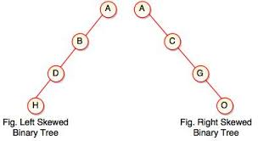
Tree - Basics
Complete or Full Binary Tree
Every node other than the leaves will has 2 children
Skewed Binary Tree
Type of tree in which every node will have either 1 or no children

Slide 8
What is a Tree?
A tree is a collection of nodes with the following properties:
The collection can be empty.
Otherwise, a tree consists of a distinguished node r, called root, and zero or more nonempty sub-trees T₁, T₂, … , T_{k}, each of whose roots are connected by a directed edge from r.
The root of each sub-tree is said to be child of r, and r is the parent of each sub-tree root.
If a tree is a collection of N nodes, then it has N-1 edges.
root
T₁
T₂
...
T_{k}
Notes:
8

Slide 9
Binary Tree
Definition: A binary tree is either empty or consists of a node called the root together with two binary trees called the left subtree and the right subtree.
Binary tree
no node can have more than two children
Maximum degree of any node is two. This means the degree of a binary tree is either zero or one or two.
If h = height of a binary tree, max # of leaves = 2^{h}
max # of nodes = 2^{h + 1} - 1
A binary tree with height h and 2^{h + 1} - 1 nodes (or 2^{h} leaves) is called a full binary tree

Slide 10
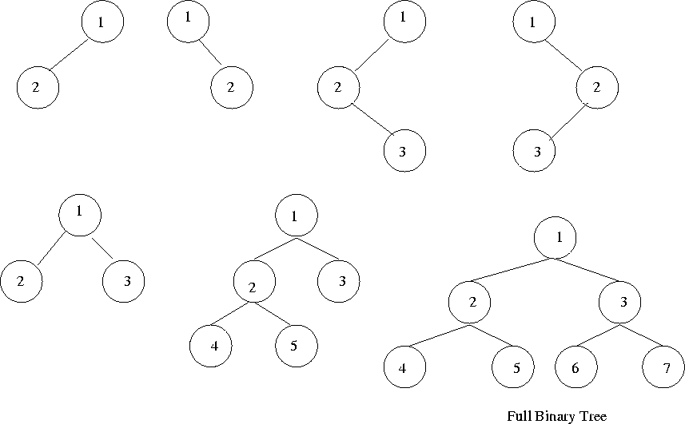
Examples of binary tree

Slide 11
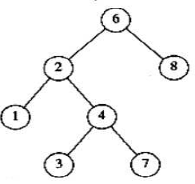
Strictly binary tree
All the nodes will have either zero or two children. It does not have one child in any node.

Slide 12


Skew Tree
Every node except the leaf has only one child node.
Two types
Left skewed binary tree
Right skewed binary tree.
Left skewed binary tree
Left skew tree has node with only the left child
It is a binary tree with only left subtrees
Right skewed binary tree
Right skew tree has node with only the right child
It is a binary tree with only right subtrees

Slide 13
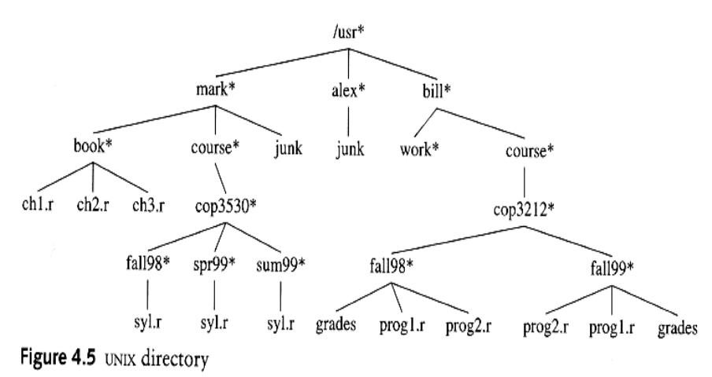
Example Unix Directory

Slide 14
Preliminaries
A
Node A has 6 children: B, C, D, E, F, G.
B, C, H, I, P, Q, K, L, M, N are leaves (no children) in the tree above.
K, L, M are siblings since F is parent of all of them.
B
C
D
E
F
G
H
I
J
K
L
M
N
P
Q

Slide 15
Preliminaries (Contd…)
A path from node n₁ to n_{k} is defined as a sequence of nodes n₁, n₂, …, n_{k} such that n_{i} is parent of n_{i+1} (1 ≤i < k)
The length of a path is the number of edges on that path.
There is a path of length zero from every node to itself.
There is exactly one path from the root to each node.
The depth of node n_{i} is the length of the path from root to node n_{i}
The height of node n_{i} is the length of longest path from node n_{i} to a leaf.
If there is a path from n₁ to n₂, then n₁ is ancestor of n₂, and n₂ is descendent of n₁.
If n₁ ≠ n₂ then n₁ is proper ancestor of n₂, and n₂ is proper descendent of n₁.

Slide 16
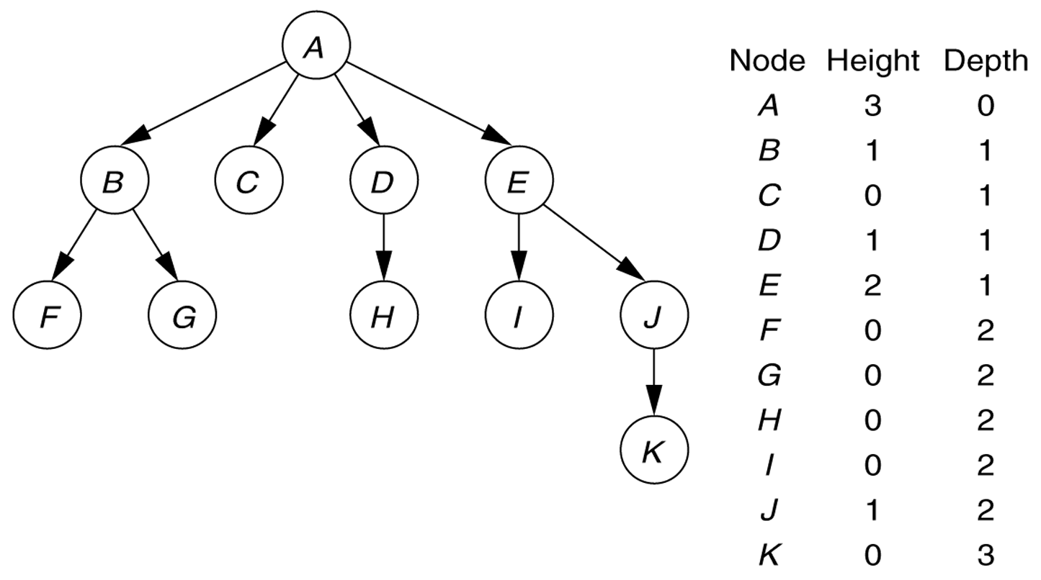
Tree Preliminaries - Example

Slide 17
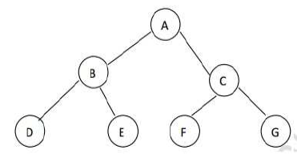
Full binary tree
Full binary tree
if all leaves are at the same level and every non leaf node has exactly two children
it should contain maximum possible number of nodes in all levels.
A full binary tree of height h has 2^{h+1} – 1 nodes.

Slide 18
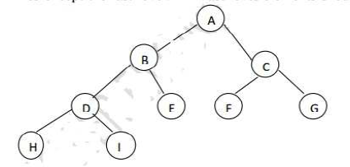
Complete binary tree
Every non leaf node has exactly two children but all leaves are not necessary at the same level.
A complete binary tree is one where all levels have the maximum number of nodes except the last level.
Last level elements should be filled from left to right.

Slide 19
Binary Tree Traversal Methods
Preorder
Visit Parent, Left, Right (PLR)
Inorder
Visit Left, Parent, Right (LPR)
Postorder
Visit Left, Right, Parent (LRP)

Slide 20
Inorder Example (Visit = print)
a
b
c
f
d
e
g
j
h
i
g
d
h
b
e
i
a
f
j
c

Slide 21
Preorder Example (Visit = print)
a
b
c
f
d
e
g
j
h
i
a
b
d
g
h
e
i
c
f
j
Notes:
During the traversal, t starts at the root, moves to the left child b of the root, then to the left child d of b. When the traversal of the left subtree of b is complete, t, once again, points to the node b. The t moves into the right subtree of b. When the traversal of this right subtree is complete, t again points to b. Following this, t points to a. We see that t points to every node in the binary tree three times – once when you get to the node from its parent (or in the case of the root, t is initially at the root), once when you return from the left subtree of the node, and once when you return from the node’s right subtree. Of these three times that t points to a node, the node is visited the first time.

Slide 22
Postorder Example (Visit = print)
a
b
c
f
d
e
g
j
h
i
g
h
d
i
e
b
j
f
c
a

Slide 23
Inorder Of Expression Tree
/
*
+
e
f
+
-
a
b
c
d
a
+
b
*
c
-
d
/
e
+
f
Gives infix form of expression (sans parentheses)!

Slide 24
Postorder Of Expression Tree
/
*
+
e
f
+
-
a
b
c
d
a
b
+
c
d
-
*
e
f
+
/
Gives postfix form of expression!

Slide 25
Preorder Of Expression Tree
/
*
+
e
f
+
-
a
b
c
d
/
*
+
a
b
-
c
d
+
e
f
Gives prefix form of expression!

Slide 26
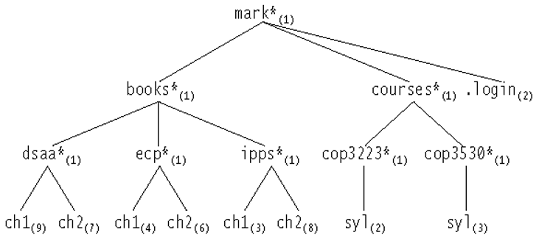
Unix directory with file sizes

Slide 27
Tree Application – List Directory
Algorithm (not a complete C code)
listAll ( struct TreeNode *t, int depth)
{
printName ( t, depth );
if (isDirectory())
for each file c in this directory (for each child)
listAll(c, depth+1 );
}
printName() function prints the name of the object after “depth” number
The order of visiting the nodes in a tree is important while traversing a tree.
Here, the nodes are visited according to preorder traversal strategy.

Slide 28
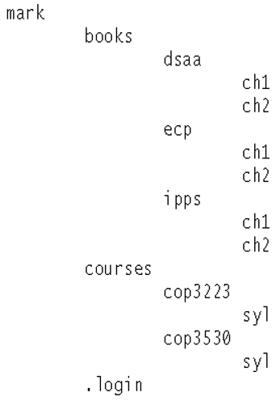
Directory listing - Output

Slide 29
Size of a directory
int FileSystem::size () const
{
int totalSize = sizeOfThisFile();
if (isDirectory())
for each file c in this directory (for each child)
totalSize += c.size();
return totalSize;
}
The nodes are visited using postorder strategy.
The work at a node is done after processing each child of that node.

Slide 30
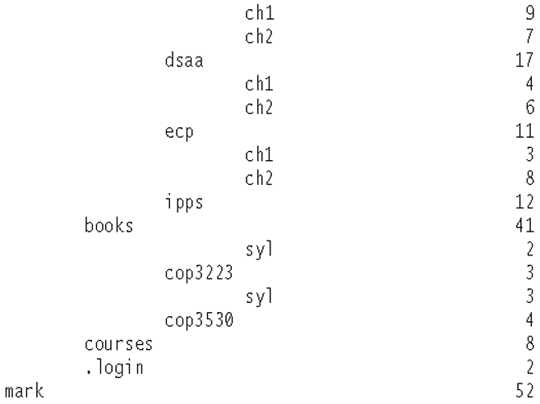
Size of Directory - Output

Slide 31
Simple questions
Is there any relationship between path and height?
What is skewed binary tree? What is the disadvantage of skewed binary trees?
Which order traversal of tree is useful for hierarchical display of the tree?

Slide 32
Summary
Definitions of tree
Application of tree

